Slide 1
CySyphus
Kinetic Art Table
PIRM I
Sean Gordon, Morgan Funk, Aaron Lawrence, Daniel Laracuenta, William Maston, and Samuel Christianson

Slide 2
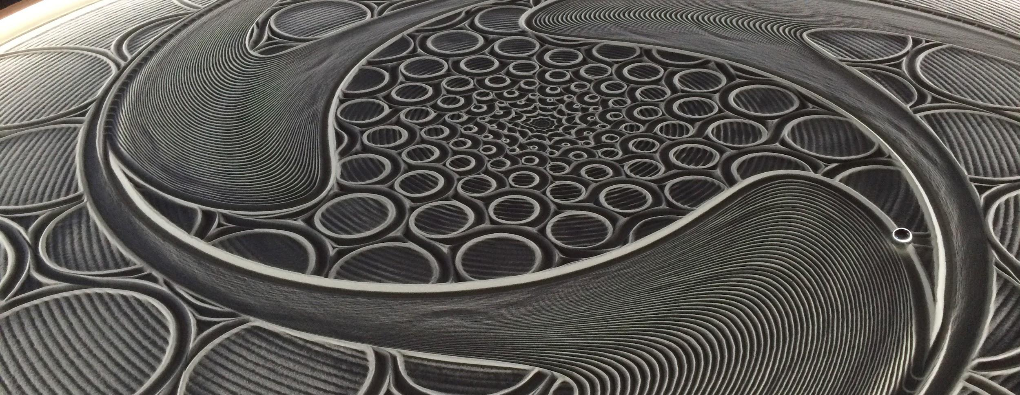
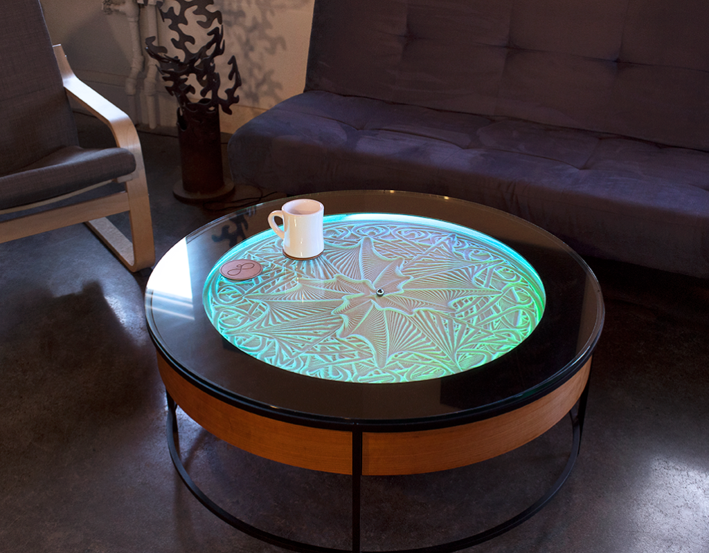
The Table
The table we have is a sisyphus coffee table designed and produced by Sisyphus Industries. Created by Bruce Shapiro, a artist that has been working with motion control as a artist medium for 25 years.
The table has a bed of sand that is shaped by a small magnetic ball. How it works is by utilizing a type of raspberry pi and a few servos or stepper motors to direct a magnet that pulls the ball along a predetermined programed track.
The computer is fed programs that take the form of rho theta files or scalable vector graphic files. These files can be created by any user. The table breaks down all files into theta rho files, theta can be thought of the angle our ball is within the table, rho is the distance the ball is from the center.
Notes:
Hi, my name is Aaron Lawrence and I will be talking about and introducing the table we will be working alongside during our project. The table we will be working with is a Sisyphus coffee table designed and produced by Sisyphus industries. The creator, Bruce Shapiro, likes to describe the table as a mix between kinetic art, design and technology, these three together create a type of Zen garden. Bruce has been exploring motion control as an artist medium for around 25 years and before developing Sisyphus industries had 3 permanent art installations in Switzerland, Germany and Australia. These art installations were all kinetic art pieces and are thought to have helped in the idea and development of the Sisyphus table we know today.
The table main feature is a glass top that looks down to a bed of sand, this sand is slowly shaped into different designs and patterns that are selected by users. This shaping happens by dragging a small magnetic ball around in the sand to create these intricate and meaningful designs called tracks. These tracks are a single continuous path that is mapped out by a program that is given to the table, we will go over this more later. This is made possible by a type of raspberry pi that Sisyphus industries has worked on to develop, and a pair of either stepper motors or servos depending on table size. This system connects through your Wi-Fi to give a user control of the track itself and change things like track playlists, table colors, firmware and a few other things. Users can also use this to upload their own designs to the table. We will talk about this next.
A big selling point of the Sisyphus table is the customization, and this does not stop at the table design itself. Users at home can develop and design custom tracks to play on their table and share them online. There is a sizable community that does this over on the Sisyphus forms. The computer within the table is able to process two file types. The first is a Theta Rho file or .thr, the second being a Scalable Vector Graphic or .svg. We will start with explaining the .svg first, svg files are vector line paths that are automatically broken down into Theta Rho files when given to the table. These svg’s are images that can be created in an application like adobe illustrator or inscapes. Theta Rho files are a custom vector filetype made specifically for the Sisyphus table. This file contains an ordered list of theta rho values that define our track. These tracks can be developed on applications like sandify or “sisyphus for the rest of us”
Next you may be wondering how exactly these theta rho files work. Theta marks the position our ball can be around the table, this can be thought of as the angle our balls position is from the tables zero mark. Rho is the distance our ball is from the center of the table, 1 being the rim and 0 being the center of the table. Once a track is given to the table it is processed and ran. The table does its best to smoothly transition from one point to the next, but the further the points are from each other, the more broken and incoherent a design can become. This is why files need to have many frequent theta rho values.

Slide 3
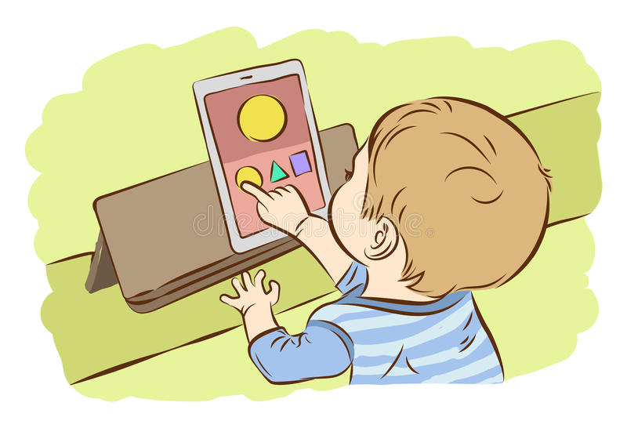
Our Mission and its Benefits
Introducing a different and simple kind of outlet to express creativity
Adding more functionality including but not limited to: turning an image into a track, internet connectivity, reading camera data, and turning custom drawings into a track
Reading a live feed of data provided by the user’s interaction with a tablet and/or camera in which the user can see their creation taking shape in real time
Notes:
Hi, my name is Daniel Laracuenta and I will be talking about the missions and benefits of our sisyphus table. To start it off we want to introduce to people a different way of expressing their creativity in a simple yet satisfying way through our table. Ever since the first ideas we brainstormed for the table we always had in mind the different ways one could interact with the table. Some of these ideas we more far-reaching than others but we were able to compile a reasonable list of ideas that are possible within our development timeline.
How will we accomplish that? Well, from the beginning we set our goals to include additional functionalities which include but are not limited to turning an image into a track, and giving the table the ability to connect to the internet for remote interactions in which involve the image drawing which will be talked into more detail by Sean Gordon in another slide. Furthermore, we want to give the table the ability to read a live feed of data provided by a tablet and/or camera.
The live feed that will be provided with the user’s interaction will come in two different ways (aside from reading an image file) by either the user making a custom drawing using a tablet using our custom interface or the user interacting with the camera which will trace the physical features of the user whether it being a silhouette of the body or an “image” of their face. And, as mentioned before, all of these drawings will be made using the theta rho values that will be translated from whichever device the user interacts with, into the table. Touching on subjects that will be talked about in our functional requirements slide, there will be the ability to use user-uploaded tracks. Keep in mind that these are the features that our mission will keep true to the final product. However, if the time allows it we will consider additional features in which did not fall into consideration for our development timeline.
In the end we believe that these interactions will make a unique experience for the user in creating using an interactive piece of art. This art will then be on display to be seen by hundreds of people in a location with heavy foot traffic, with the main choice of location being Parks Library. With this high rate of exposure, we are sure that the positive impact this will have on campus will bring forth a wave of interest from beyond our campus.

Slide 4
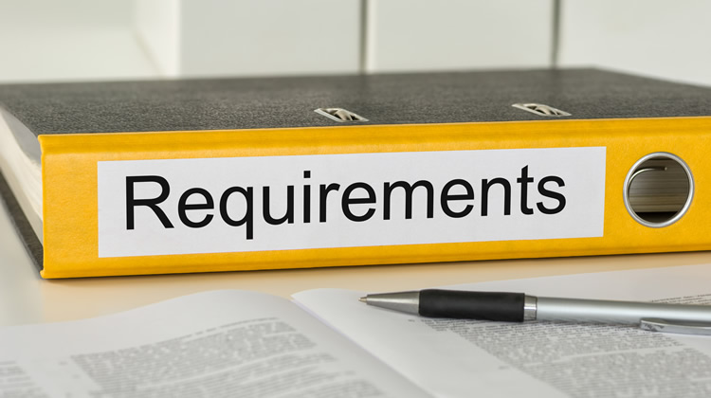
Functional Requirements
Applications work as an app, or hosted on the web.
Applications can:
Communicate with a given table.
Create tracks from scratch.
Turn an image -> track.
Access to table applications online:
Web hosted interface.
Table connected to internet.
Access to user-uploaded tracks.
Physical upgrades must be easy to install on existing consumer products.
Notes:
Hello, my name is Sean Gordon, and I will be talking about our project’s functional requirements.
The bulk of our project focuses on designing addons to the existing Sisyphus table. These interfaces must build off the existing physical components of the table while requiring little to no customer intervention. The majority of the applications revolve around tracks for the table, giving customers much more accessibility to their existing product.
As the table operates using polar coordinates, our application will need to be able to convert from the preferred cartesian system to polar coordinates. The application will also enable custom track design in several ways. The most straightforward of these is a digital drawing pad, taking user input as a series of lines drawn on the screen.
Another function of the application will be to convert an image into a valid track. This function must intake an image of any type and resolution and allow the user to select what section of the image is to be converted. The function must then determine the most prominent aspects of the image and the order with which they must be layered, then convert these calculations into a cartesian coordinate file.
On top of enabling the creation of custom tracks, this application must also be able to send the tracks to the table itself. At this point in the project, it is uncertain whether this can be done using the preexisting wireless functionality of the table, or if further physical components like an arduino must be added.
The interface will also allow users to share tracks with each other, uploading the track to our online site for download. This functionality would also include naming, rating, and searching for a track using criteria like size.
All the services mentioned must fit inside a neatly packaged application like a smartphone or web app, and must be accessible through a graphical interface.

Slide 5

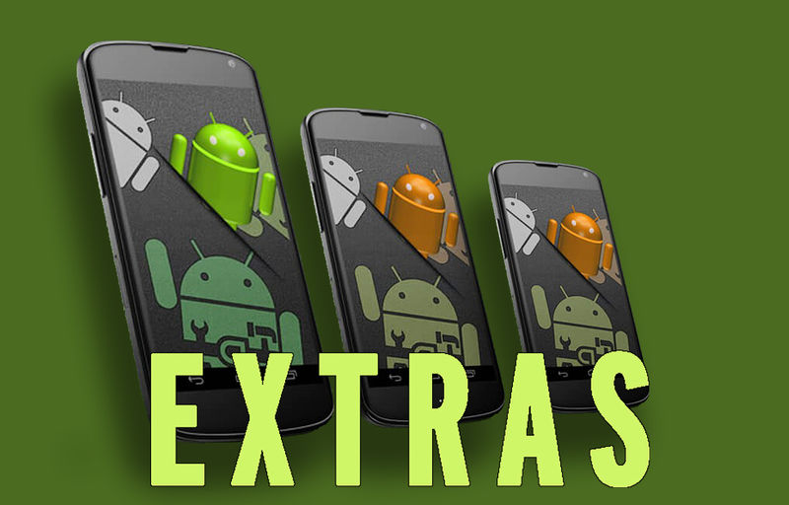
Non-Functional Requirements
Ease of Use
UI needs to be intuitive
The site needs to launch within a reasonable timeframe
Security
All information related to the user needs to be private and secure
All services provided must be secured and prepared against external attacks
Maintainability
All code needs to be properly commented for future contributors
Functions created for this project need to be properly documented and the parameters be clear to others
Notes:
Hi my name is William Maston and I will be giving an overview of our non-functional requirements
Our first goal for our project, after we complete the required architecture, is to work on a suitable UI for our website app. Since this project is intended for a wide audience it is important that we can make all of the interactable elements of our project intuitive and easy to use. This will be accomplished in two ways. The first is that we will stick to standard UI convention, that being common symbols like the triple line hamburger menu icon, or the standard ‘x’ for closing out of certain applications. Common symbols will not be applicable in all parts of our site, so the second way to communicate with our users is clean and concise instructions and feature headers. If we find ourselves with an abundance of extra time next semester we could also include support for other languages.
Security is another feature we will be implementing. Users who connect to this site need to be sure that their privacy or security will not be compromised by visiting our site. All user information will need to be locked and protected. Any login information or metadata that we create will always be kept in mind as we build our site to be safe and secure. We also need to keep in mind our sites wellbeing too. We will need to restrict what type of information we accept and how much of it, to keep our site protected against attacks. We will also need to take steps to mitigate external attacks to our site from outside sources.
We are also committed to maintainability for our project. There is a large online community associated with the sisyphus table. Any code that we create not only needs to be usable and understandable by us, but also by anyone who may come after. To that end we have decided to properly document everything we do. The most crucial part of this is commenting on all the code we create. Any team project will have multiple contributors working on the same code. This means that all of the code needs to readable and usable for everyone. Proper commenting is how one programmer can guide another to pick back up where they left off. All functions and methods that have been created will also be properly documented so that everyone can use them properly. There are a bunch more ways we can help with maintainability, and with just a little forethought and planning, this project can stand the test of time.
As we continue to plan and work on this project next semester, we will plan, test, and iderate on new additions and feature to be added. We have been given an amazing opportunity to work on a project that is so open to new ideas and possibilities. It is my personal hope that we can achieve everything we need to so that we get to packing this project full of everything we can dream up.

Slide 6
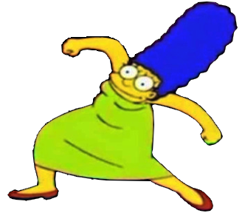
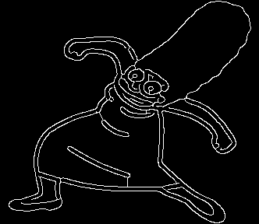
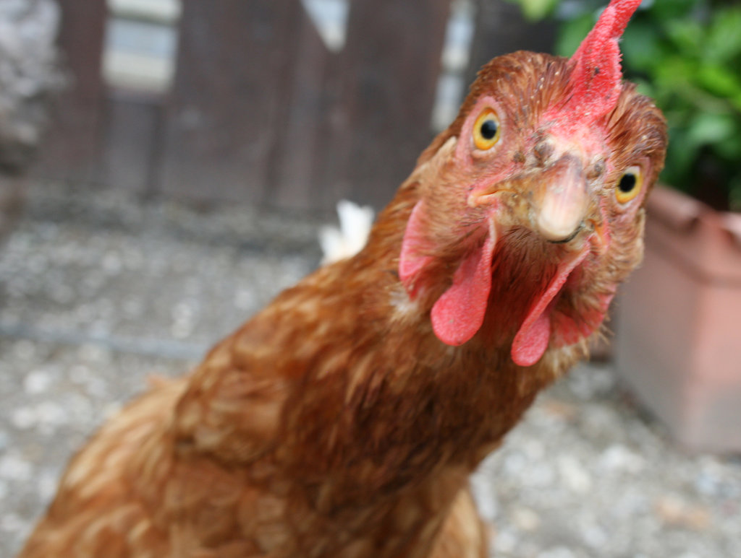
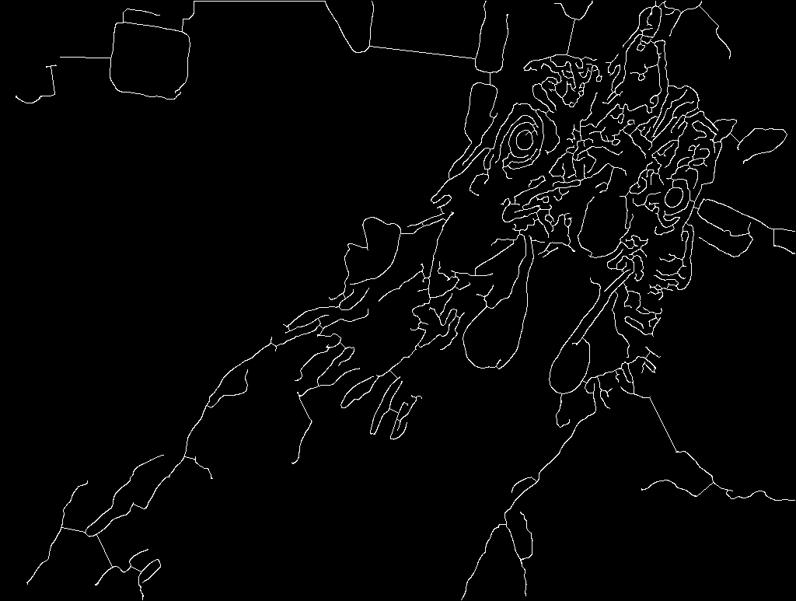
What’s done
What sean has done over summer (img to track)
Add marge plz
(lmao yes, very professional. I threw both in ->)

Slide 7
Currently Working On
GITHub Interactions
Fleshed out Issues board
Worked to create a repository for members to work from home
Translating Custom Images to Sisyphus Table
Bridging code that has been developed from our team to code that is applicable and can run on the Sisyphus Table
Working with vendor to obtain specialized tools/elements to easily adapt new code to the table.
Website/Application Development
Working with Android Studio alongside free website elements to create an intuitive way to interact with the Sisyphus table.

Slide 8
Next steps
What we plan on working on.

Slide 9
Slides below this I dont think we will want in PIRM
Sad :<

Slide 10
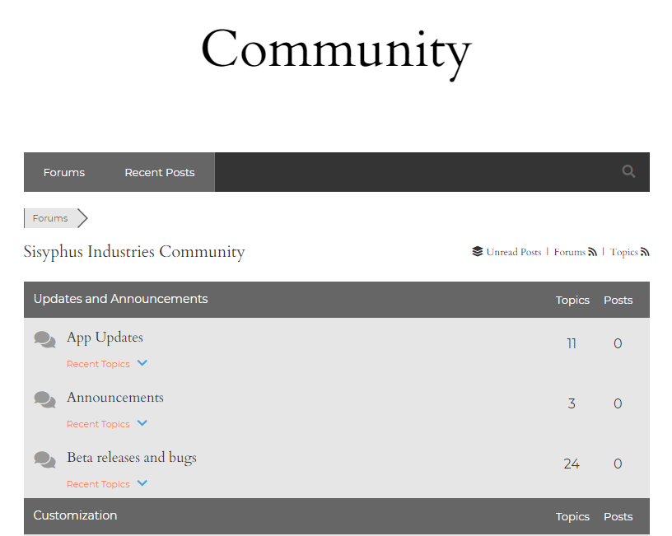

System Design
Backend
Database - MySql servers
Mybatis for database <-> endpoint ties
Code/Program to convert image to vector map
Customized software from the vendo
Basic Creation Through the Sisyphus App: https://www.youtube.com/watch?v=2D9c1b_MX7I&feature=youtu.be
Frontend
Javascript UI
Website for uploading images(wix has databases for users to upload)
Hardware
Arduino
Existing Raspberry Pi
Additional Custom elements from the vendor
Notes:
Hello my name is morgan funk and I will be covering the System Design portion of our CySyphus table senior design project.
The sisyphous table itself is quite impressive on its own. Utilizing the given application provided with the table there are a few designs and patterns that the community has developed in order to personally customize the paths table can create.
Initially, our attention was drawn to how others on the community board were able to use code to customize their own tables.
Most of these are either Theta Rho Files or Scalable Vector Graphic files, the latter SVG are files that the sysiphus table can automatically convert into Theta Rho Files in order to process and begin its movement and image creaton on the sand.
Based off of this , there are a few programs we can utilize to help automate the process of turning images into SVG or TR files directly.
One of these being wintopo which is freeware that automatically turns any uploaded image into a vector mapped counter part that can then be mapped as an SVG.
Another of these programs is GNU Image Manipulation Program or GIMP which is another program that can easily edit images and process them into an SVG format.
However, currently as we do not have access to a table for testing due to the recent COVID-19 outbreak, we can only hypothesize what will work with the table and make the assumption that SVG images processed through these programs should work.
Moving our focus to the User side of the project, we have a few methods in development in terms of how the user is going to input images into the table. Currently there are websites with database modules (like wix) that are able to take uploaded images and move them into a CSV which is a database collection file.
This CSV file can be exported to a local drive and the images can then be processed into the proper format for the table to utilize.
The main platform we are focusing on is a website with a live feed to the table with a queue of images that users can upload and watch as the table creates them one by one.
Our work will be primarily focused in UI elements that make it easy for users to understand how to use the tabel. These elements will need to explain what type of files can be uploaded and what files are innappropriate.
For example, if an image is too complex to be processed into a vectored image or simply goes outside the limits of the table (such as anything focusing on crossing the middle too much or where the arm cannot reach) they will have to be notified and there image will not be queued up to be drawn
There has been discussion about the vendor working on a custom module element to better smooth this transition from website/app to table however communication has been made difficult due to recent events.
Finally, the addtional hardware that may be needed in this project are few if needed. The table itself uses an onboard rasberry Pi that is programmable and currently handles Rho Theta files.
Once we are able to test and work with the table and understand its abilities and limitations of its current hardware and software we will be able to focus our efforts on what tools are actually needed.
Our final implementation of this project is going to be showcasing the table in a public building on campus with inforgraphics on how passerbys can upload images and view the table online.

Slide 11
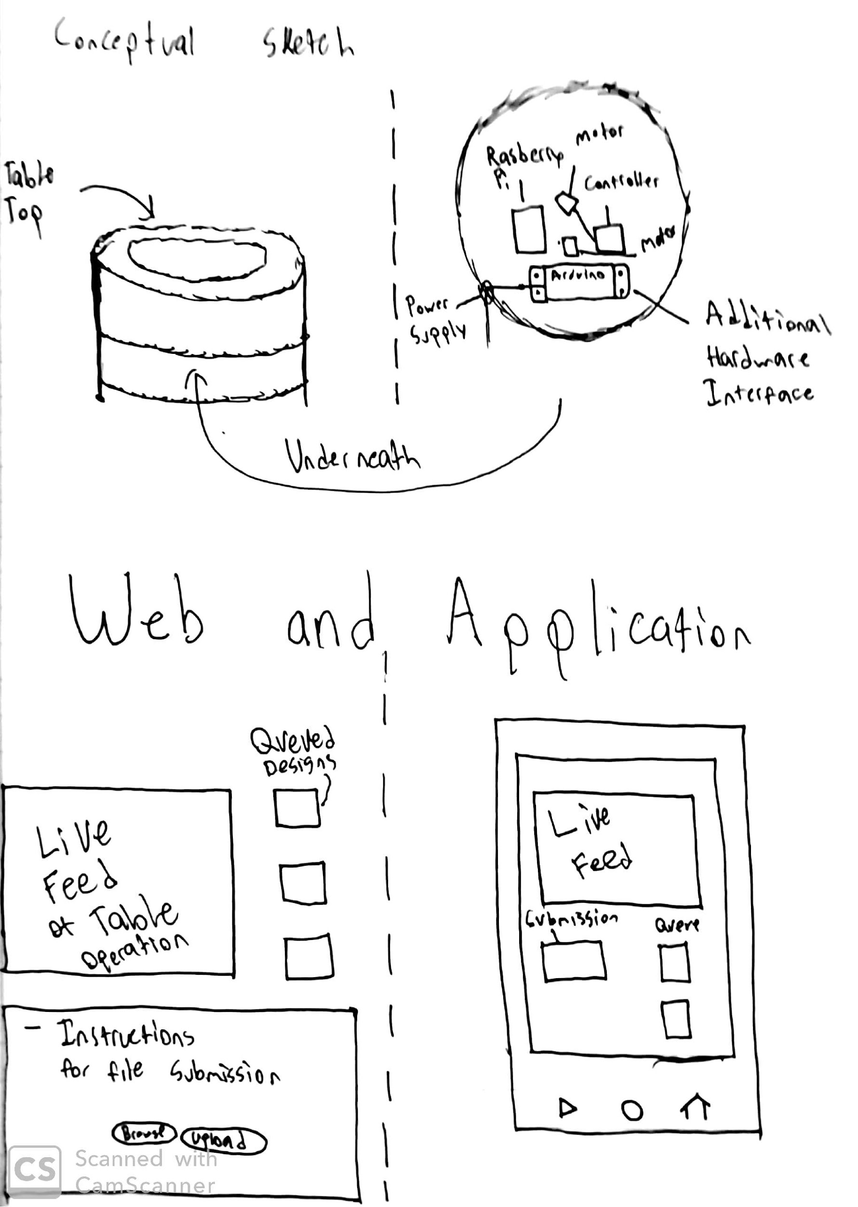
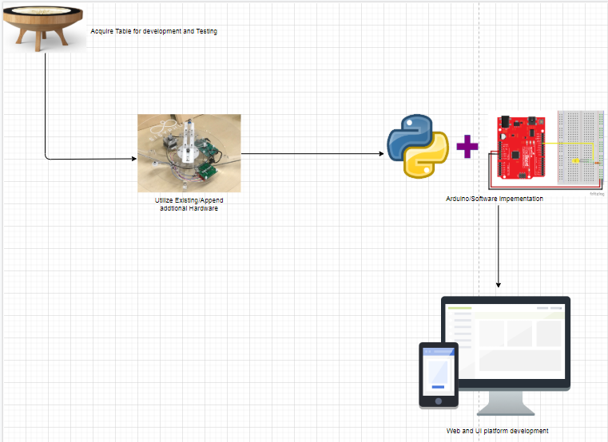
System Design
Conceptual Sketch of systems
System splayed out with actual hardware and software

Slide 12
Risk Management
Risk to Components (Working on pre-existing consumer property)
Physical upgrades could completely break existing circuitry
Double check work including by someone else before sending power through anything
Risk to Self
Working with electrical may lead to a fire hazard
Have a fire extinguisher on hand
Other Risks
Lack of compatibility between components
Make sure that the components are 100% compatible
The physical display on canvas will need to be disinfected often due to current events
Notes:
Hi my name is Samuel Christianson and i will be covering the risk management portion of this presentation.
With most physical projects there comes some inherent risk that has to be mitigated. Whether its risk to us as the people working on the project or the components of the project itself or anything other possible risks.
The first type of risks that have to be mitigated are risks to the project itself. These risks could be damage to existing circuitry or damage resulted from mishandling components. This could be prevented by double checking all modifications, including review from peers, before sending power to anything.
Another form of risk is risk to self. By this mean any risk to a person that is working on the project. Working with anything electrical is inherently a fire risk. We’ll make sure to have a fire extinguisher on hand.
Another risk is that components might not be compatible with each other. Well have to make sure that components are completely compatible with each other before using them.
It should also be noted that physical surfaces are considered a risk to the health of people around it due the spread of coronavirus. We will follow the guidelines set out by the CDC for the duration of the second semester, and going above and beyond by disinfecting the physical surfaces of the table often while it is on display on campus.

